Slide 1
TLM example application
T. Leveling
March 15, 2013
Attendees:
Don Cossairt
Kamran Vaziri
Adam Olson
Dave Peterson
John Anderson
Paul Czarapata
Tony Leveling

Slide 2
Controlled beam loss location
A2B7, a bending magnet in the Accumulator ring
First bend element following injection into Accumulator
With bend bus de-energized, all beam is lost on this magnet
Studied during 2000 shielding assessment
Measurement verified in 2011/2012
MARS simulations to compare with measurements

Slide 3
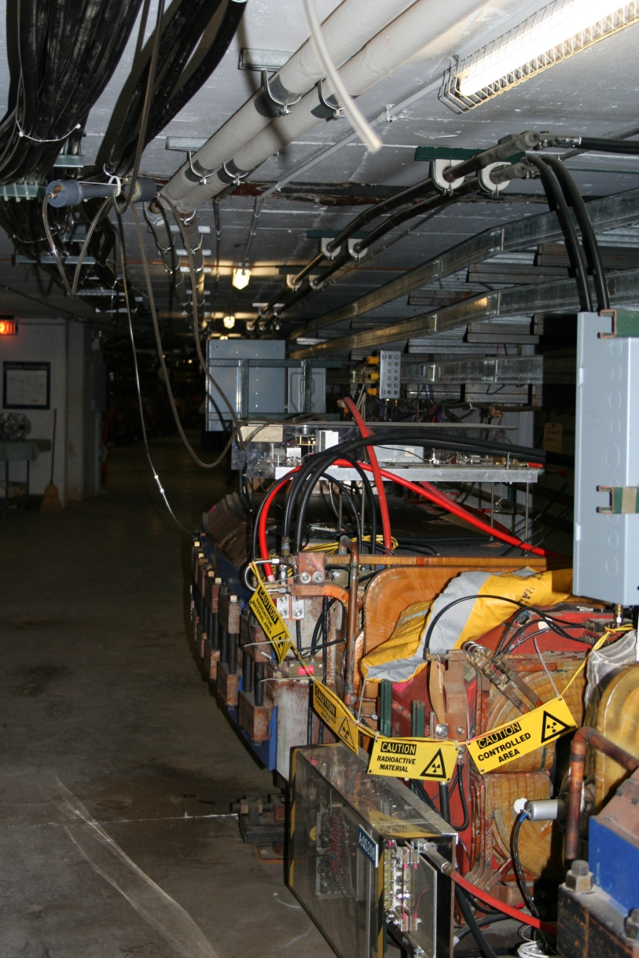

Slide 4
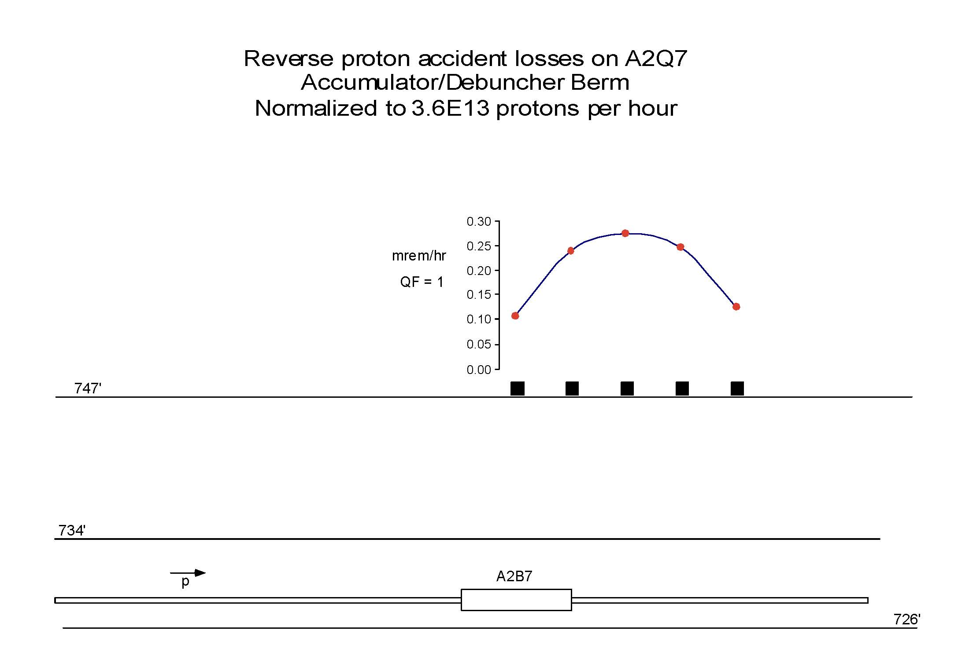
Effective dose measurement

Slide 5
Comparison of 2000/2012 measurement

Slide 6
MARS simulations didn’t match measurements possible cause – unknown soil density

Slide 10
TLM measurement unit
Based upon months of response testing, nC is a convenient unit
Our TLM electrometer designs have chipmunk-like output pulse
1 pulse is 1 nC
Fits with rad card and RSS parameters
Basis is documented in Dynamic Range Requirements
A heartbeat for the electrometer has been designed
10 Tohm resistor at 500 volts provides 3 nC/min output

Slide 11
Two electrometer designs
One by AD Instrumentation department
Analog
Background test run begins this week (March 11, 2013)
One by AD RF department
Digital
Background test run began in December 2012

Slide 12
TLM output
Output is a square wave (digital) or TTL pulse (analog) similar to chipmunk
Output is to be directed to RSS via a rad card
Trip levels are application specific, just like chipmunk/scarecrow applications
Trip levels would be established through the shielding assessment process
TTL pulse rate limited to < 70 Hz by design (no pulses go unrecorded)
TLM turns off accelerator absolutely, just like for chipmunk/scarecrow applications
Time-weighted average limits are observed, just like for chipmunk/scarecrow applications

Slide 13
Digital TLM electrometer prototype
This is NOT a proposed application – just an installation to exercise the electrometer designs
Scarecrow at 400 MeV labyrinth
TLM electrometer connected
to 10’ TLM in Linac
Prototype electrometer & scarecrow on MUX channels

Slide 14
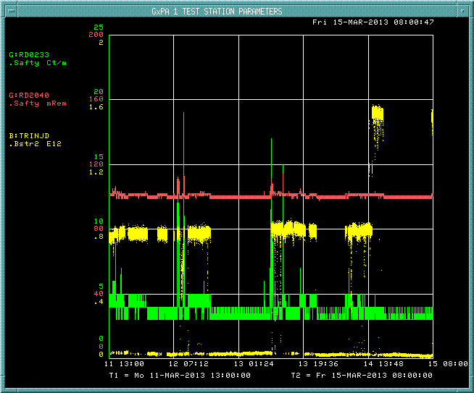
Analog TLM electrometer prototype

Slide 15
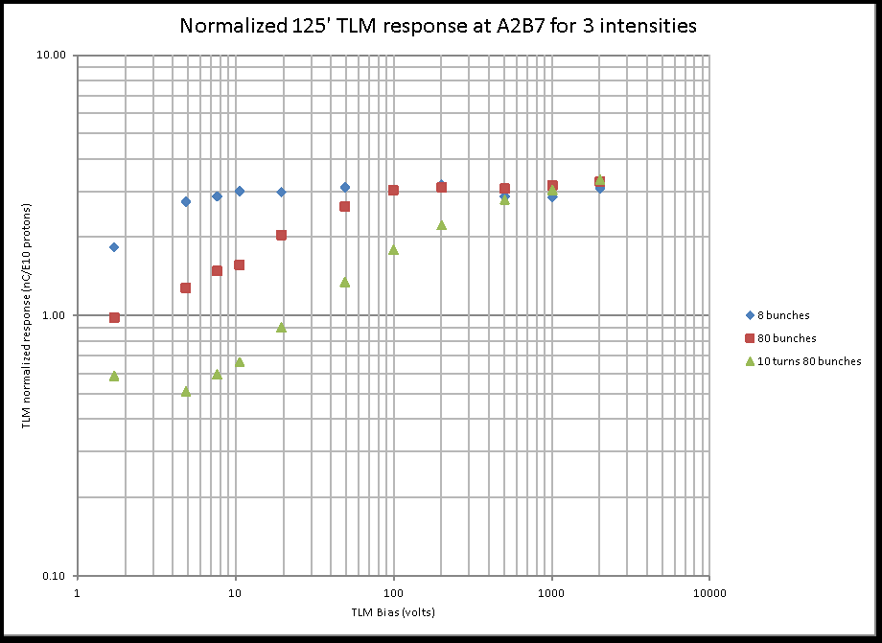
125’ TLM response to controlled beam loss

Slide 16
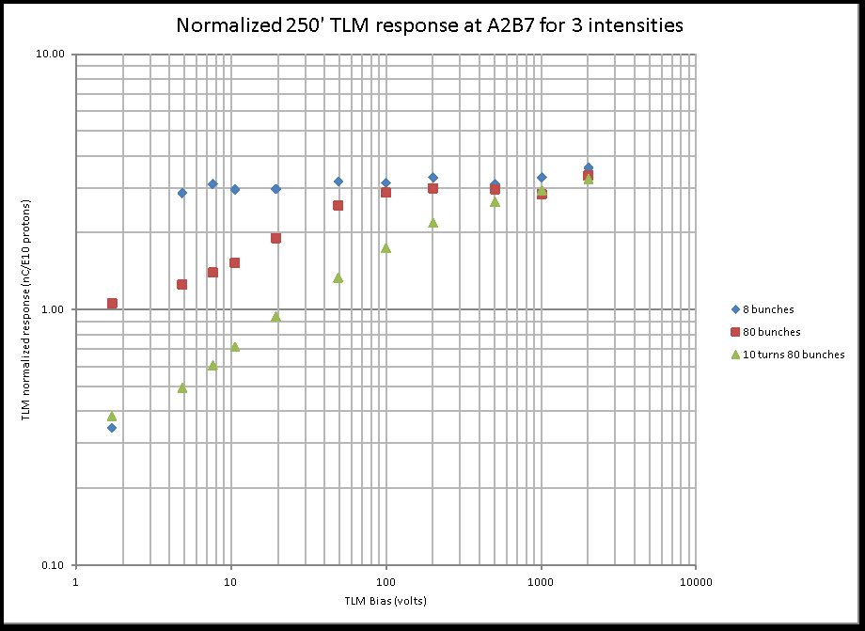
250’ TLM response to controlled beam loss

Slide 17
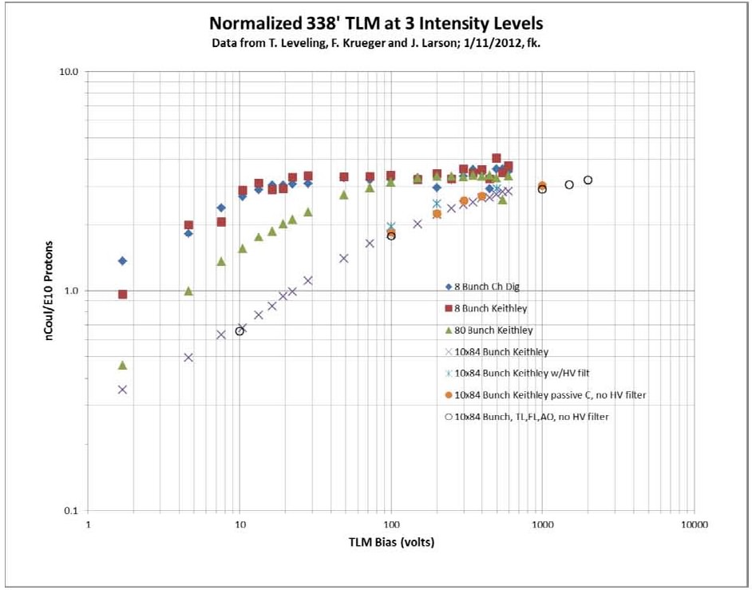
338’ TLM response to controlled beam loss

Slide 18
TLM dynamic range examples
Machine/Condition | Notes | Beam power (KW) | Energy (GeV) | Protons per hour | Average intensity per second | Nominal Shielding feet | Magnet to ceiling distance | Shield Category or application basis | beam loss limit (p/s) | normal loss limit p/s | % of beam loss | nC/min (per meter in bold)
Mu2e Service Bldg. | 1 | 4 | 8 | 1.13E+16 | 3.13E+12 | 10 | 5.5 | skyshine | 3.3 watts | 2.58E+09 | 0.082% | 93
Mu2e Service Bldg. | 1 | 8 | 8 | 2.25E+16 | 6.25E+12 | 10 | 5.5 | skyshine | 3.3 watts | 2.58E+09 | 0.041% | 93
Mu2e Shielding Berm | 2 | 4 | 8 | 1.13E+16 | 3.13E+12 | 13 | 5.5 | 1A | 3.26E+10 | 1.63E+09 | 0.052% | 31
Mu2e Shielding Berm | 2 | 8 | 8 | 2.25E+16 | 6.25E+12 | 13 | 5.5 | 1A | 3.26E+10 | 1.63E+09 | 0.026% | 31
Booster May 2013 | 5 | 64 | 8 | 1.80E+17 | 5.00E+13 | 14 | 4 | 2A | 2.20E+11 | 1.10E+10 | 0.022% | 399
Booster 2016 | 5 | 80 | 8 | 2.25E+17 | 6.25E+13 | 14 | 4 | 2A | 2.20E+11 | 1.10E+10 | 0.018% | 399
Booster (any pwr) | 3 |  | 8 |  |  | 14 | 4 | 1 W/m | NA | 4.69E+10 |  | 1,701
Main Injector | 2 | 700 | 120 | 1.31E+17 | 3.65E+13 | 24 | 5 | 1A | 2.61E+13 | 1.31E+12 | 3.582% | 265,094
Main Injector | 2 | 2,300 | 120 | 4.31E+17 | 1.20E+14 | 24 | 5 | 1A | 2.61E+13 | 1.31E+12 | 1.090% | 265,094
Main Injector | 3 | 700 | 120 | 1.31E+17 | 3.65E+13 | 24 | 5 | 1 W/m | NA | 1.82E+11 | 0.499% | 36,960
Main Injector | 3 | 2,300 | 120 | 4.31E+17 | 1.20E+14 | 24 | 5 | 1 W/m | NA | 1.82E+11 | 0.152% | 36,960
Nova | 2 | 700 | 120 | 1.31E+17 | 3.65E+13 | 26 | 3 | 1A | 4.87E+13 | 2.44E+12 | 6.675% | 1,372,243
LBNE | 2 | 2,300 | 120 | 4.31E+17 | 1.20E+14 | 26 | 3 | 1A | 4.87E+13 | 2.44E+12 | 2.030% | 1,372,243
Nova | 4 | 700 | 120 | 1.31E+17 | 3.65E+13 | 26 | 4 | 10 ppm | NA | 3.65E+08 | 0.001% | 116
LBNE | 4 | 2,300 | 120 | 4.31E+17 | 1.20E+14 | 26 | 3 | 1 W/m | NA | 5.21E+07 | 0.000% | 29
 |  | Not Recommended
Notes: | 1 | Distributed or concentrated loss limits public exposure to 1 mrem per year: NB 6 nC/E10 at ELAM
 | 2 | Single point loss limits berm surface normal condition dose rate to 0.05 mrem/hr
 | 3 | Total charge limit in tunnel beam loss to 1 W/m - distributed among some number of TLMs
 | 4 | Limit total beam loss to 1 part in 1E5
 | 5 | Single point loss limits berm surface normal condition dose rate to 5 mrem/hr

Slide 19
TLM detector bias selection
Based upon preceding table, and under normal conditions, TLM detector should be operating on the plateau:
3 nC/E10 protons at 8 GeV
~26 nC/E10 protons at 120 GeV
Further studies this year are required for confirmation

Slide 20
The example – 1 of 3
A2B7
Assumptions
3.6E13 protons lost at A2B7 gives 1.5 mrem effective dose (based on MARS QF calculation & measurement)
We want to limit peak dose rate on berm to 1 mrem/hr
This implies total beam loss of 2.4E13 protons/hr at a single location
3 nC/E10 protons is TLM response

Slide 21
The example – 2 of 3
Trip point calculation
Rad card trip setting assumptions
120 nC = 120 cpm
For 15 minute trip setting
1800 counts
Allow 3 counts per minute background

Slide 22
The example – 3 of 3
If >120 nC/minute is collected due to a distributed loss, trip occurs anyway
Peak effective dose rate will be < 1 mrem/hr
The machine is held off until the TWA rate of 120 nC/min is not exceeded
Standard rad card performance.

Slide 23
What happens in case of a gross beam loss?
FET across voltage divider on TLM input senses a beam loss too big to measure continuously
TLM electrometer trips off the RSS by taking away the keep alive voltage
Electrometer continues to send out pulses
No reset until TWA limit is observed

Slide 24
Schedule
Electrometer module development and construction – completed end of April 2013
Prototype and detector testing - May 2013 through September 2013
Documentation submitted to AD ES&H - October 2013
AD ES&H Review and Approval – December 2013
ES&H Section Approval - February 2014
Future work – Final design & construction - TBD

Slide 25
